Slide 1
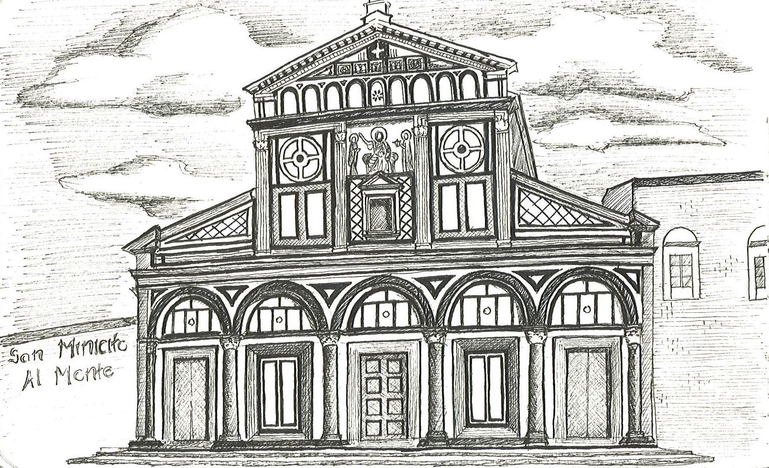
FIELD TRIP TO FLORENCE
THURSDAY FEBRUARY 7 THROUGH 10, 2013
PART 1 OF 4 PARTS
Façade of San Miniato al Monte by Minh Tran
The sketches are organized into four slide shows related to the assignments, and in alphabetical order by last name, with each student represented by three or four sketches.

Slide 2
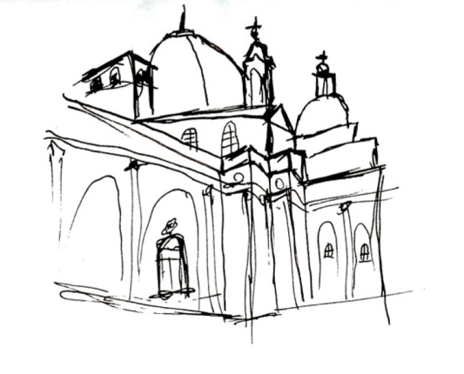
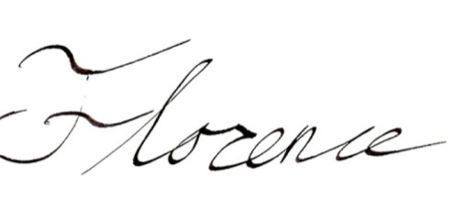
SKETCHING ASSIGNMENTS
I. Volumes and Surfaces:
At San Lorenzo: Compare the volumes and surface development of the old and new sacristies at San Lorenzo by drawing their plans and sections. In your sections include a careful study of the far wall elevation (the wall you face as you cut the section). Note the similarities and differences between Brunelleschi’s and Michelangelo’s work, especially in section and in surface composition. What Platonic figures are being used? How is Michelangelo playing games with architectural principles developed in the Renaissance? No drafting tools allowed.
At San Lorenzo: Draw a plan and elevation of any wall in the Laurentian Library entry. How many architectural “jokes” can you find here? (Winner gets a gelato).
At San Miniato: Draw the façade. How many architectural jokes can you find here? (Winner gets a High Five). What are the basic geometries that organize the façade?
Grant Newby

Slide 3
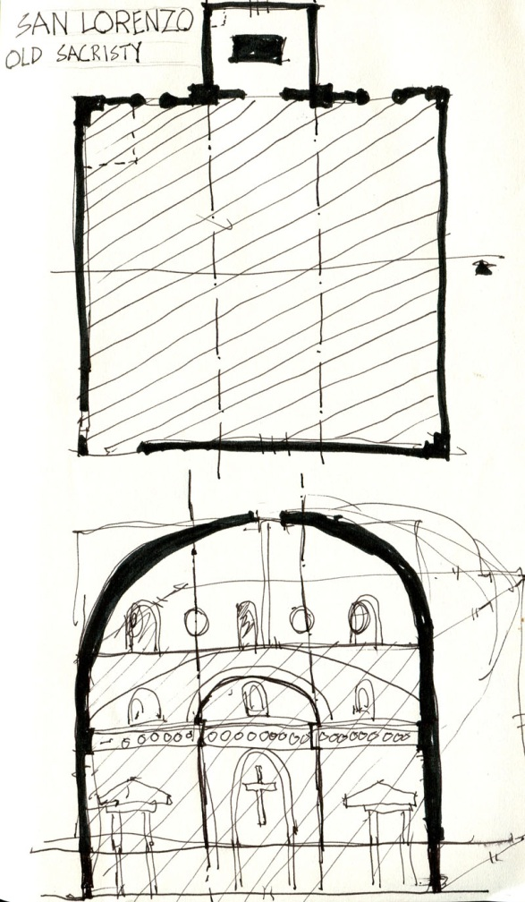
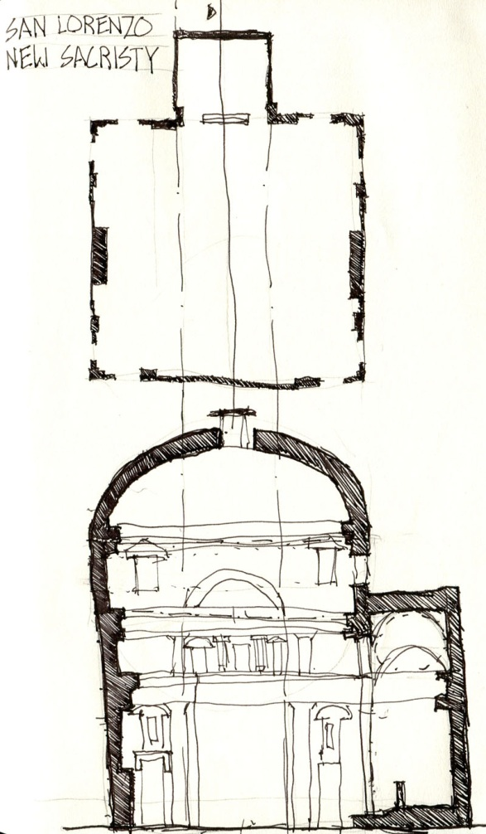
Old and New Sacristies by Dustin Blalock

Slide 4
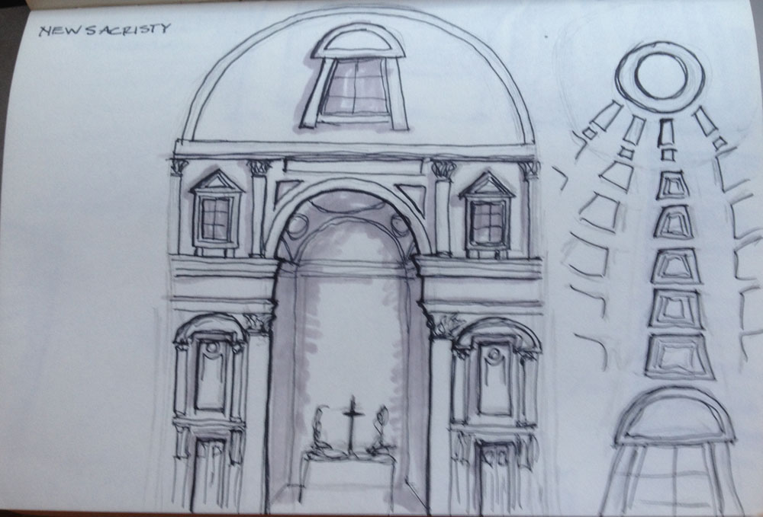
San Lorenzo, New Sacristy by Amber Conwell

Slide 5
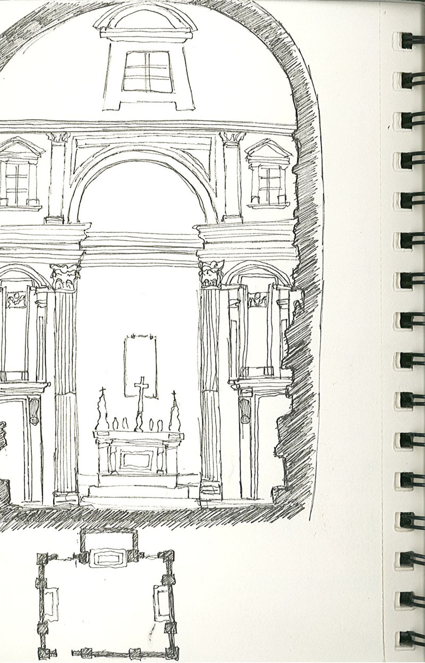
New Sacristy by Cal Cornwell
Notes:
Cal Cornwell

Slide 6
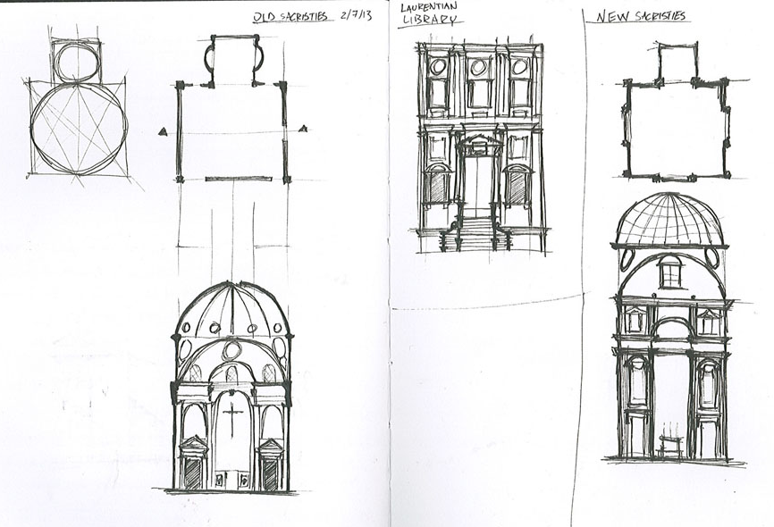
Old and New Sacristies by Nathan Harwell
Notes:
Nathan Harwell

Slide 7
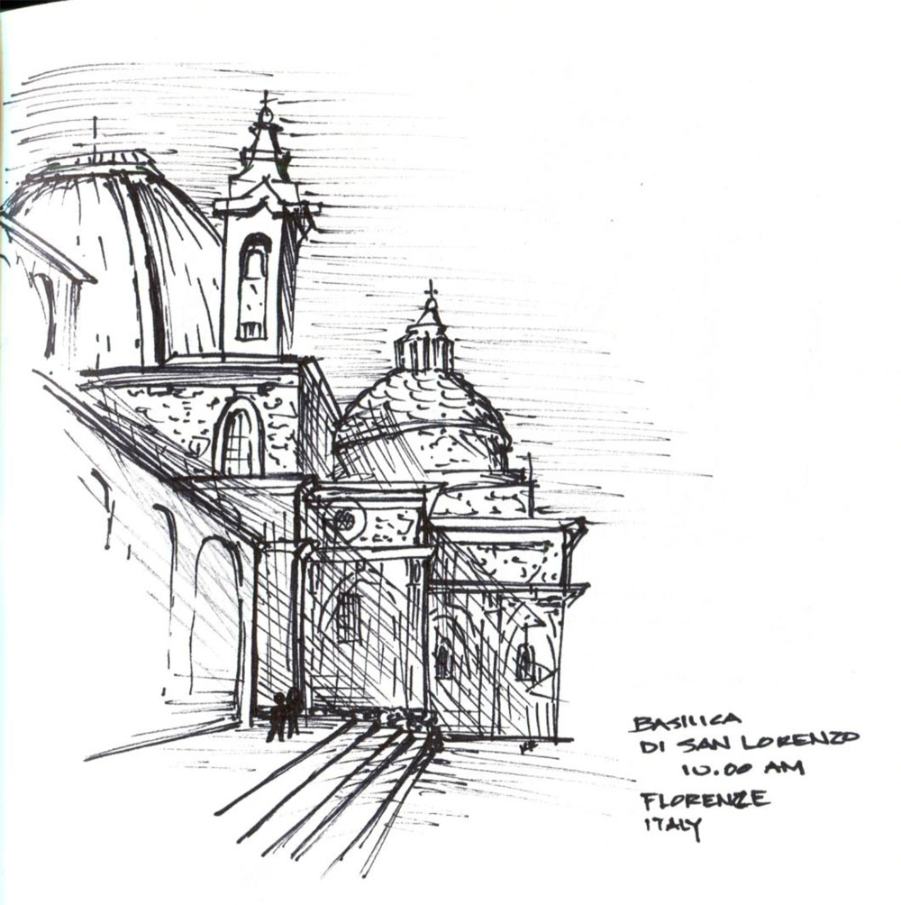
Exterior of San Lorenzo by Kymber Kincanon

Slide 8
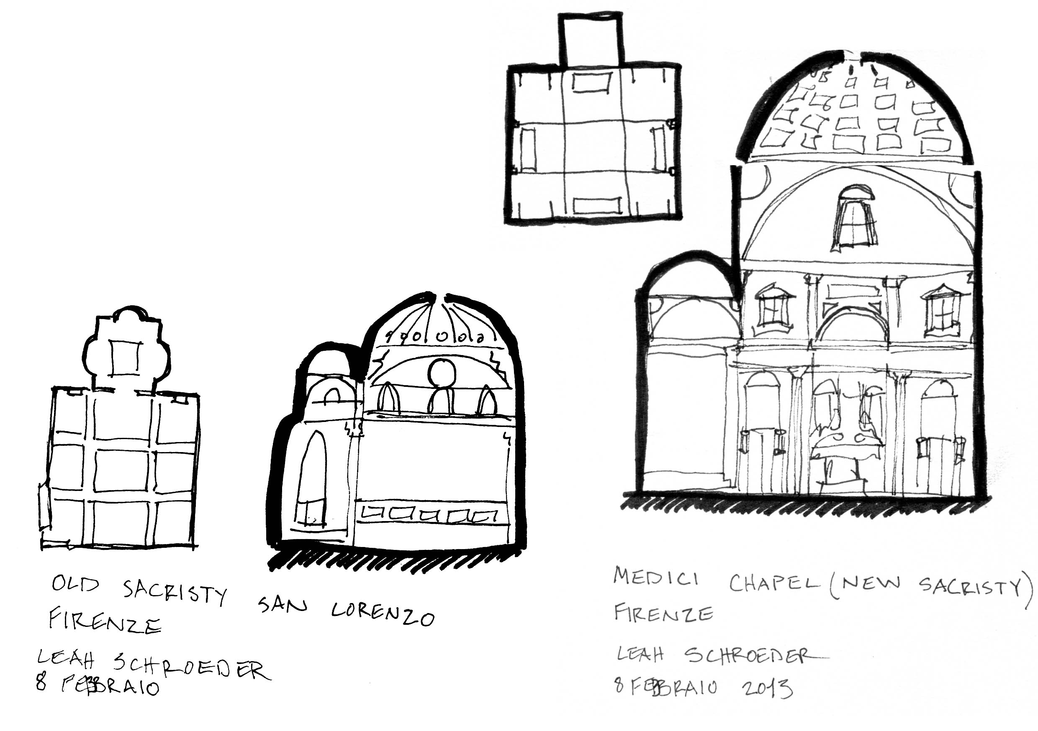
Old and New Sacristies by Leah Schroeder

Slide 9
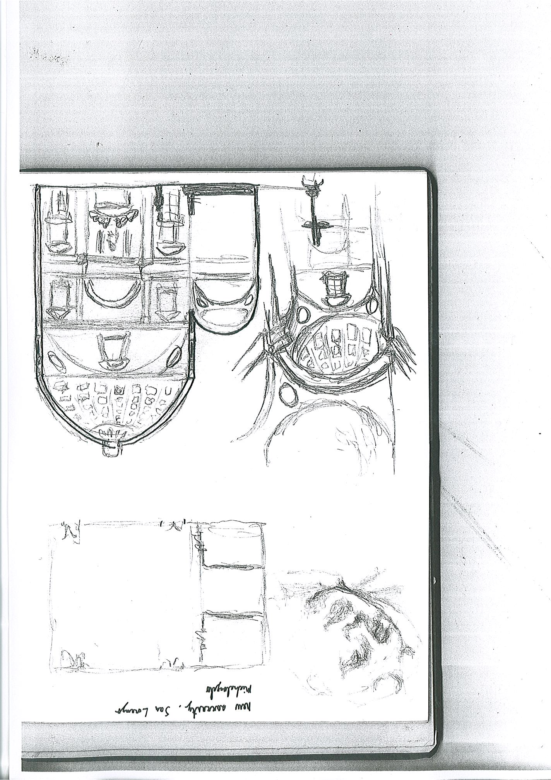
New Sacristy by Erik Medina

Slide 10
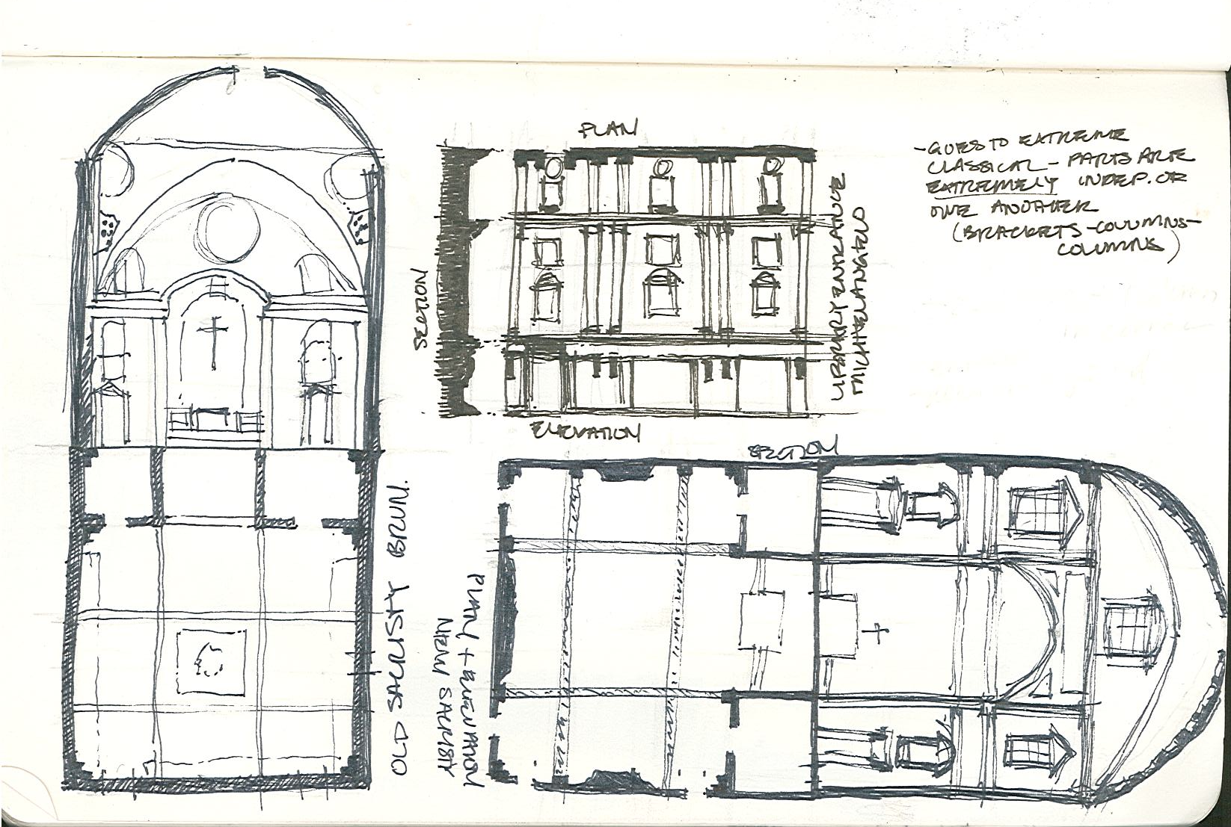
Old and New Sacristies by Amy Shell
Notes:
Amy Shell

Slide 11
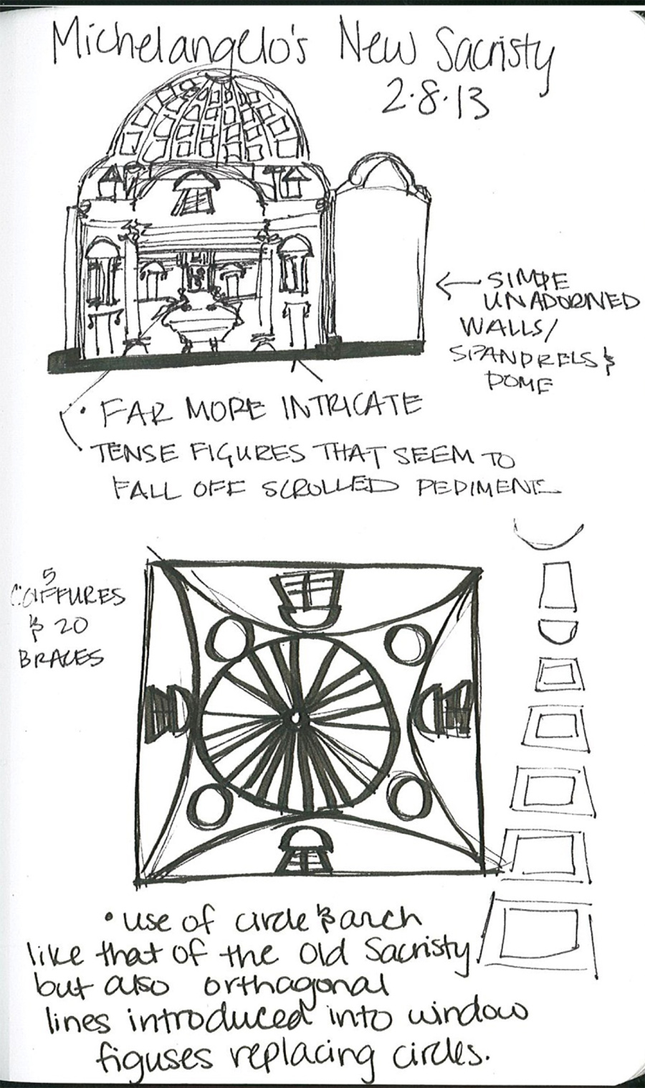
New Sacristy by Caty Townsend

Slide 12
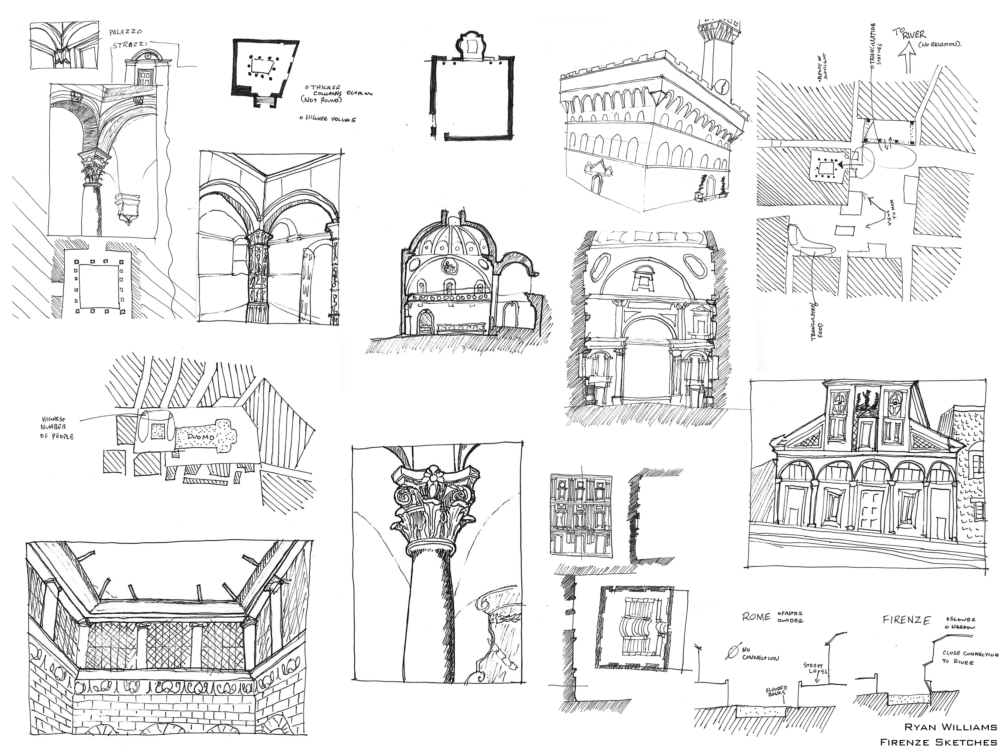
Old Sacristy by Ryan Williams
Notes:
Ryan Williams

Slide 13
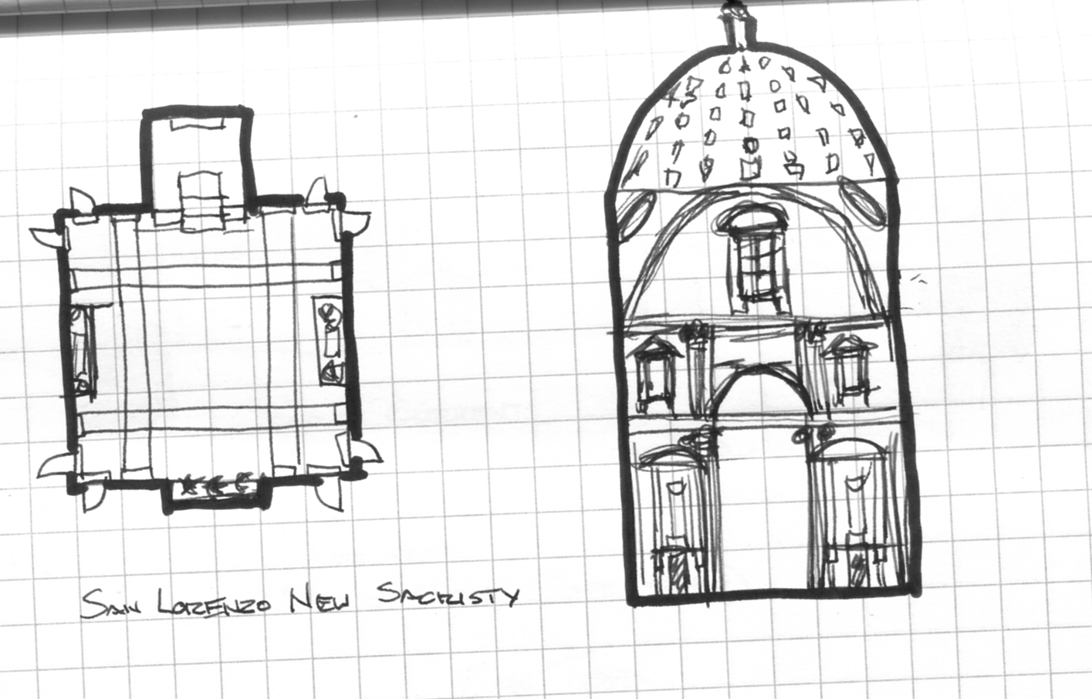
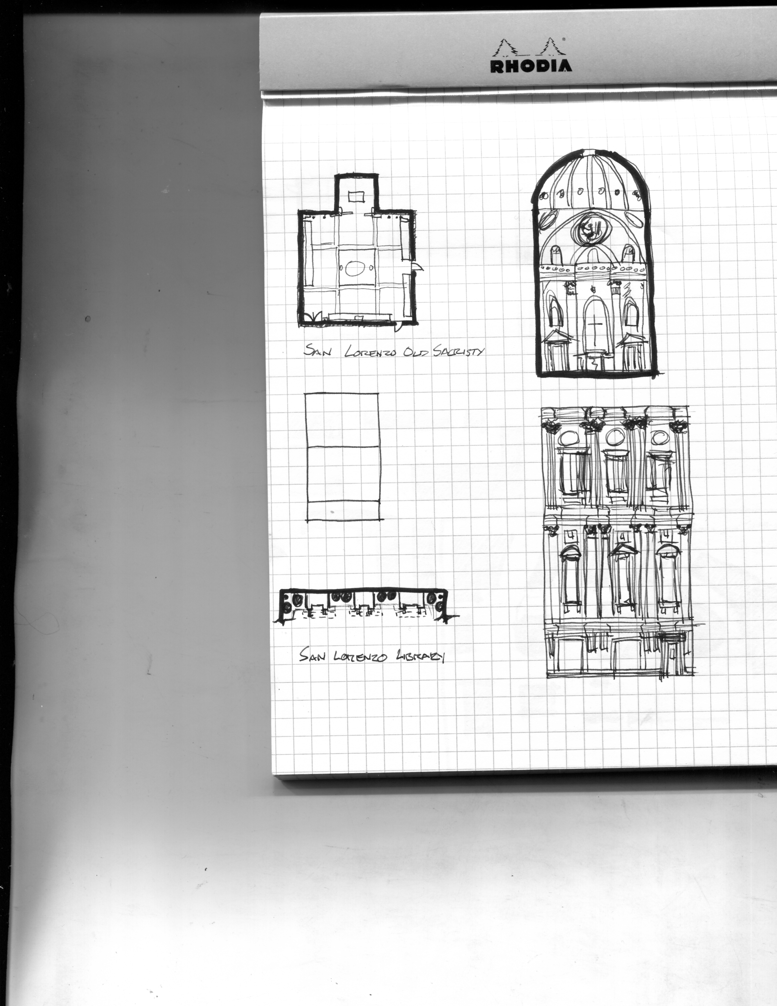
New and Old Sacristies by Tyler Yamamoto

Slide 14
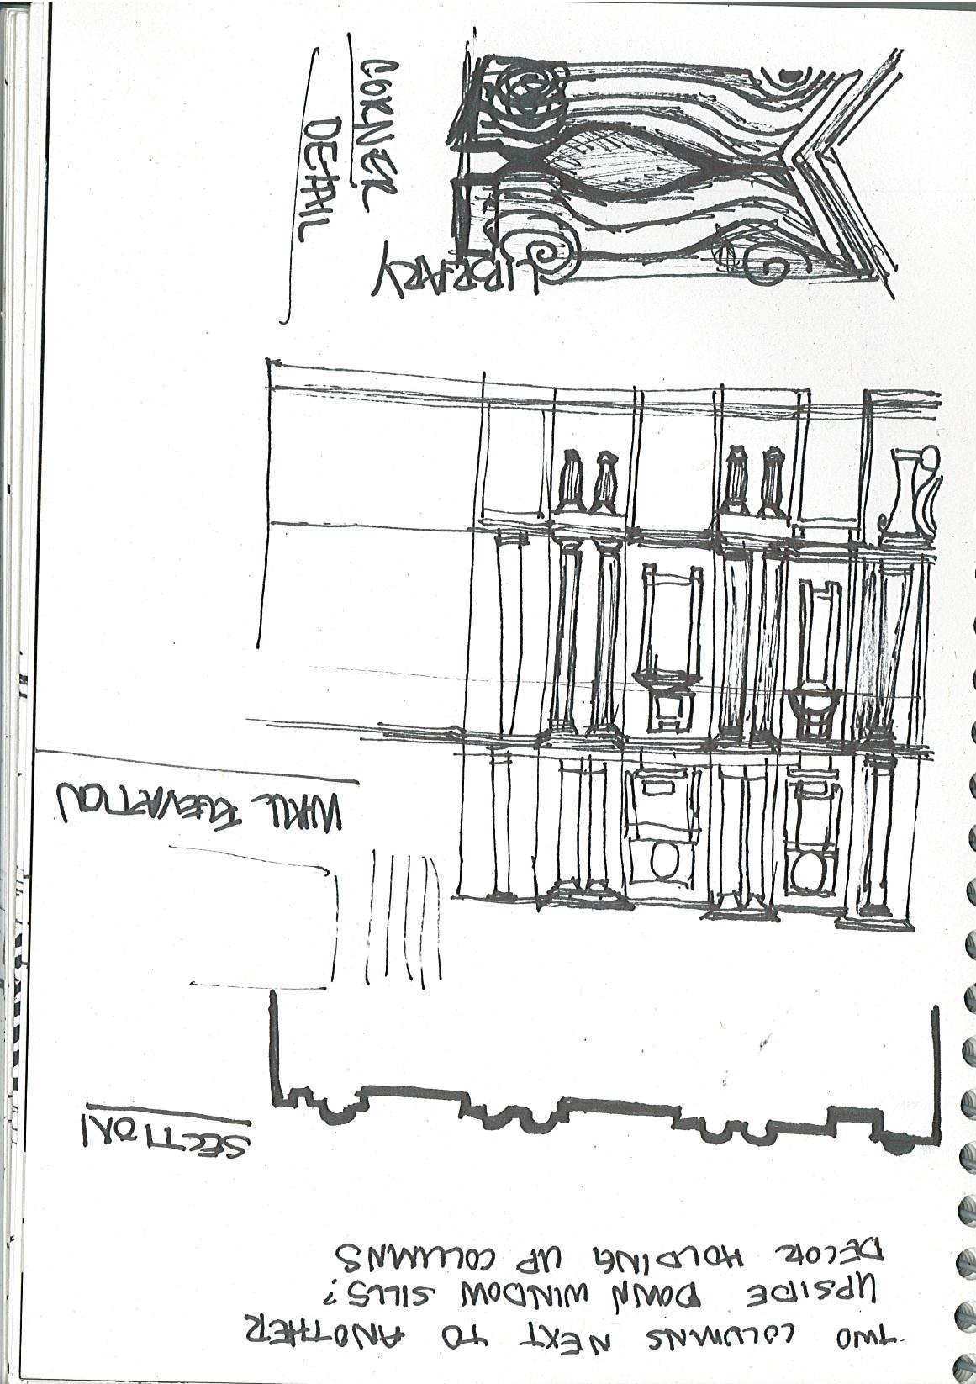
Laurentian Library Entry by Ana Hernandez

Slide 15
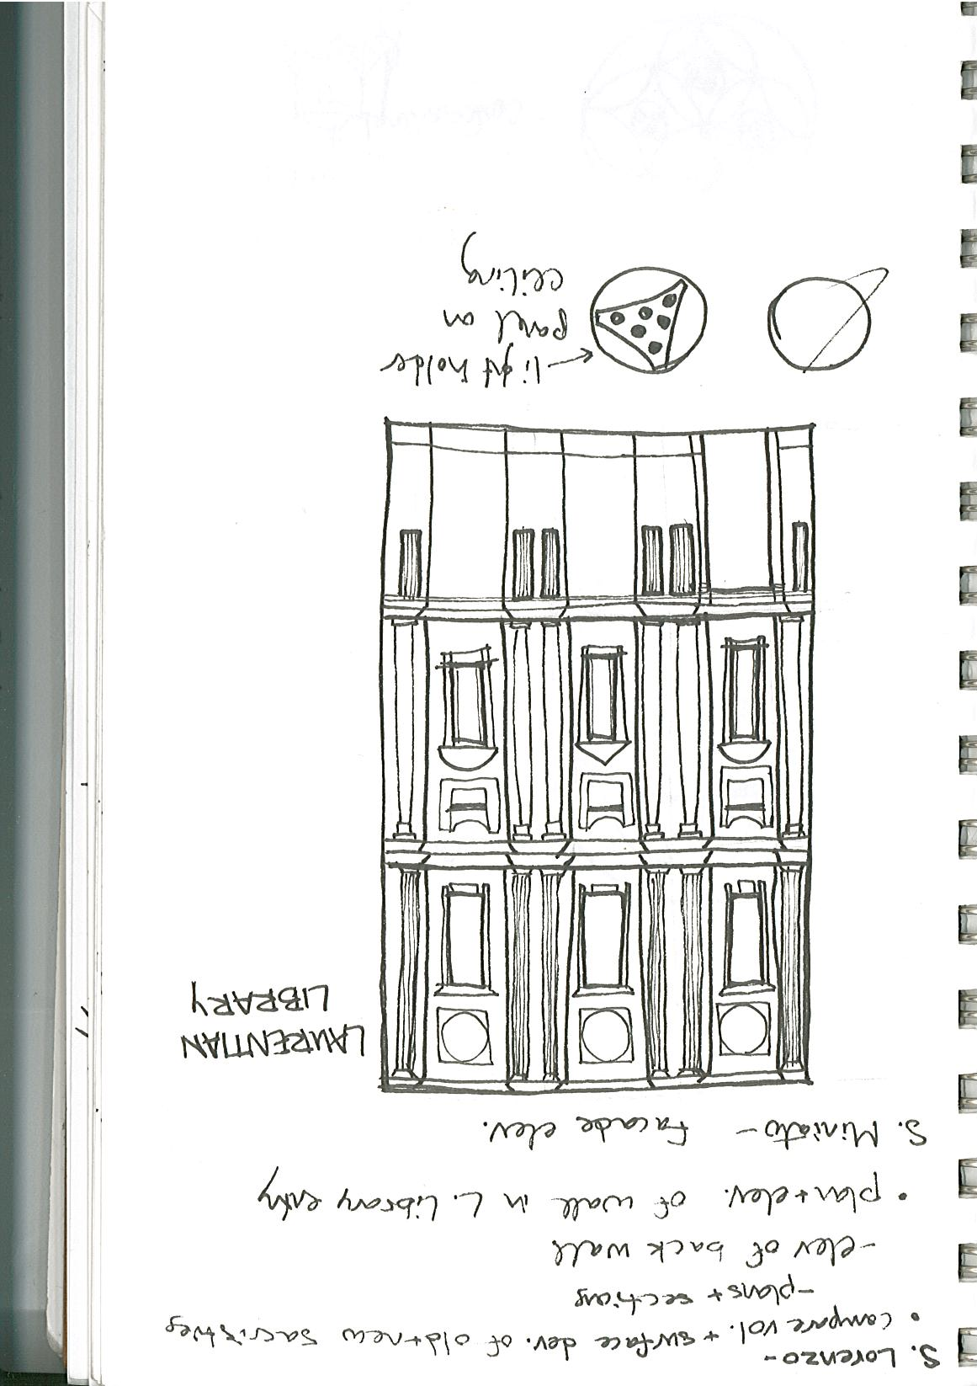
Laurentian Library Entry by Annie Kientz

Slide 16
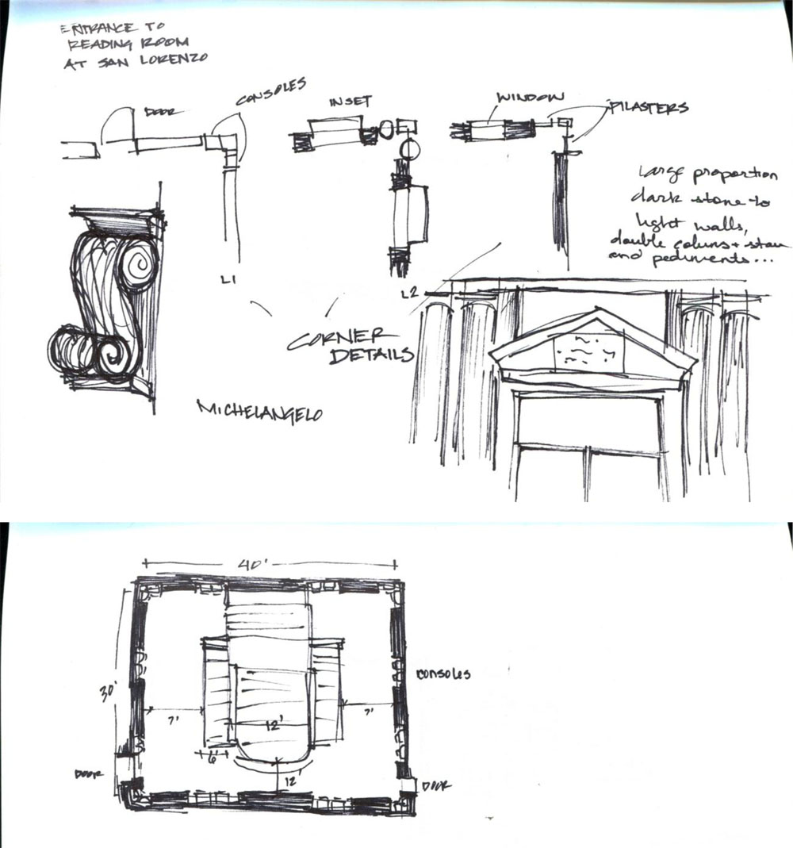
Laurentian Library by Kymber Kincanon
Notes:
Kymber

Slide 17
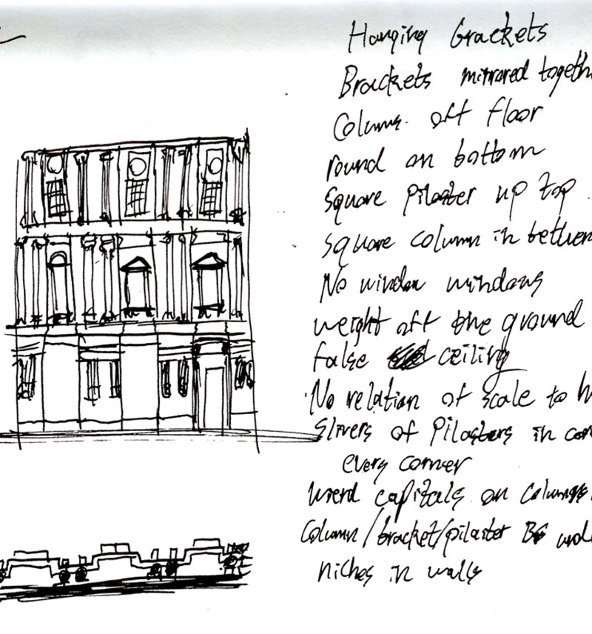
Laurentian Library Entry by Grant Newby

Slide 18
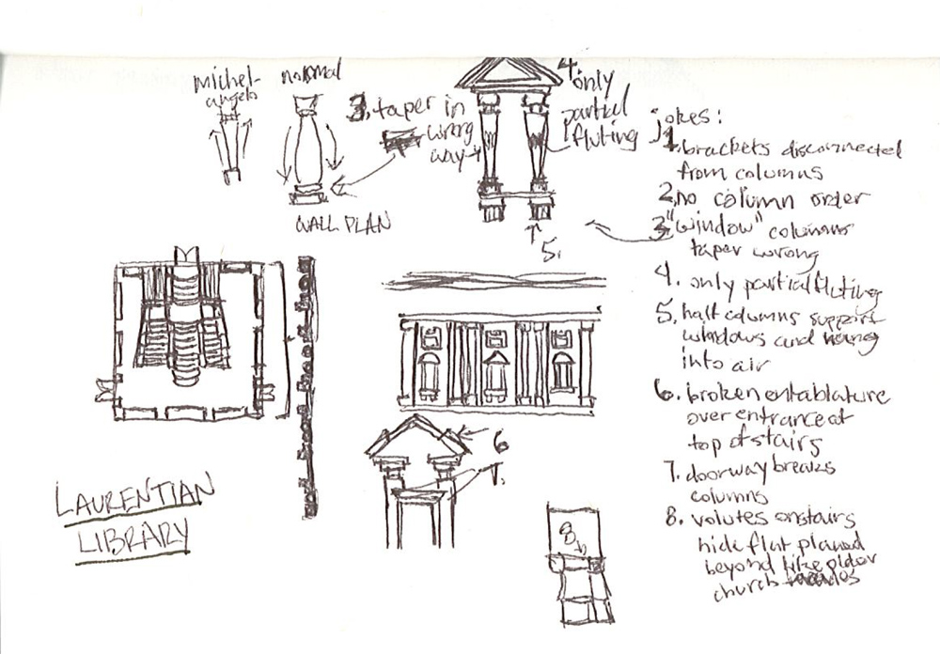
Laurentian Library Entry by Connor Reid

Slide 19
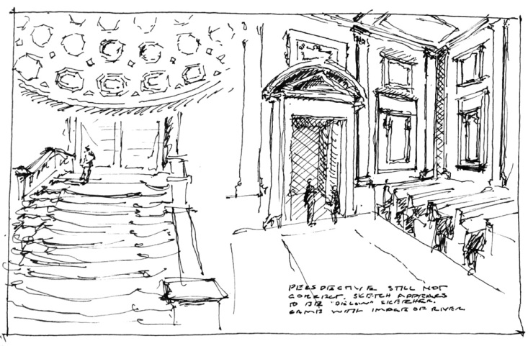
Laurentian Library Entry and Reading Room by Klaas Reimann-Philipp

Slide 20
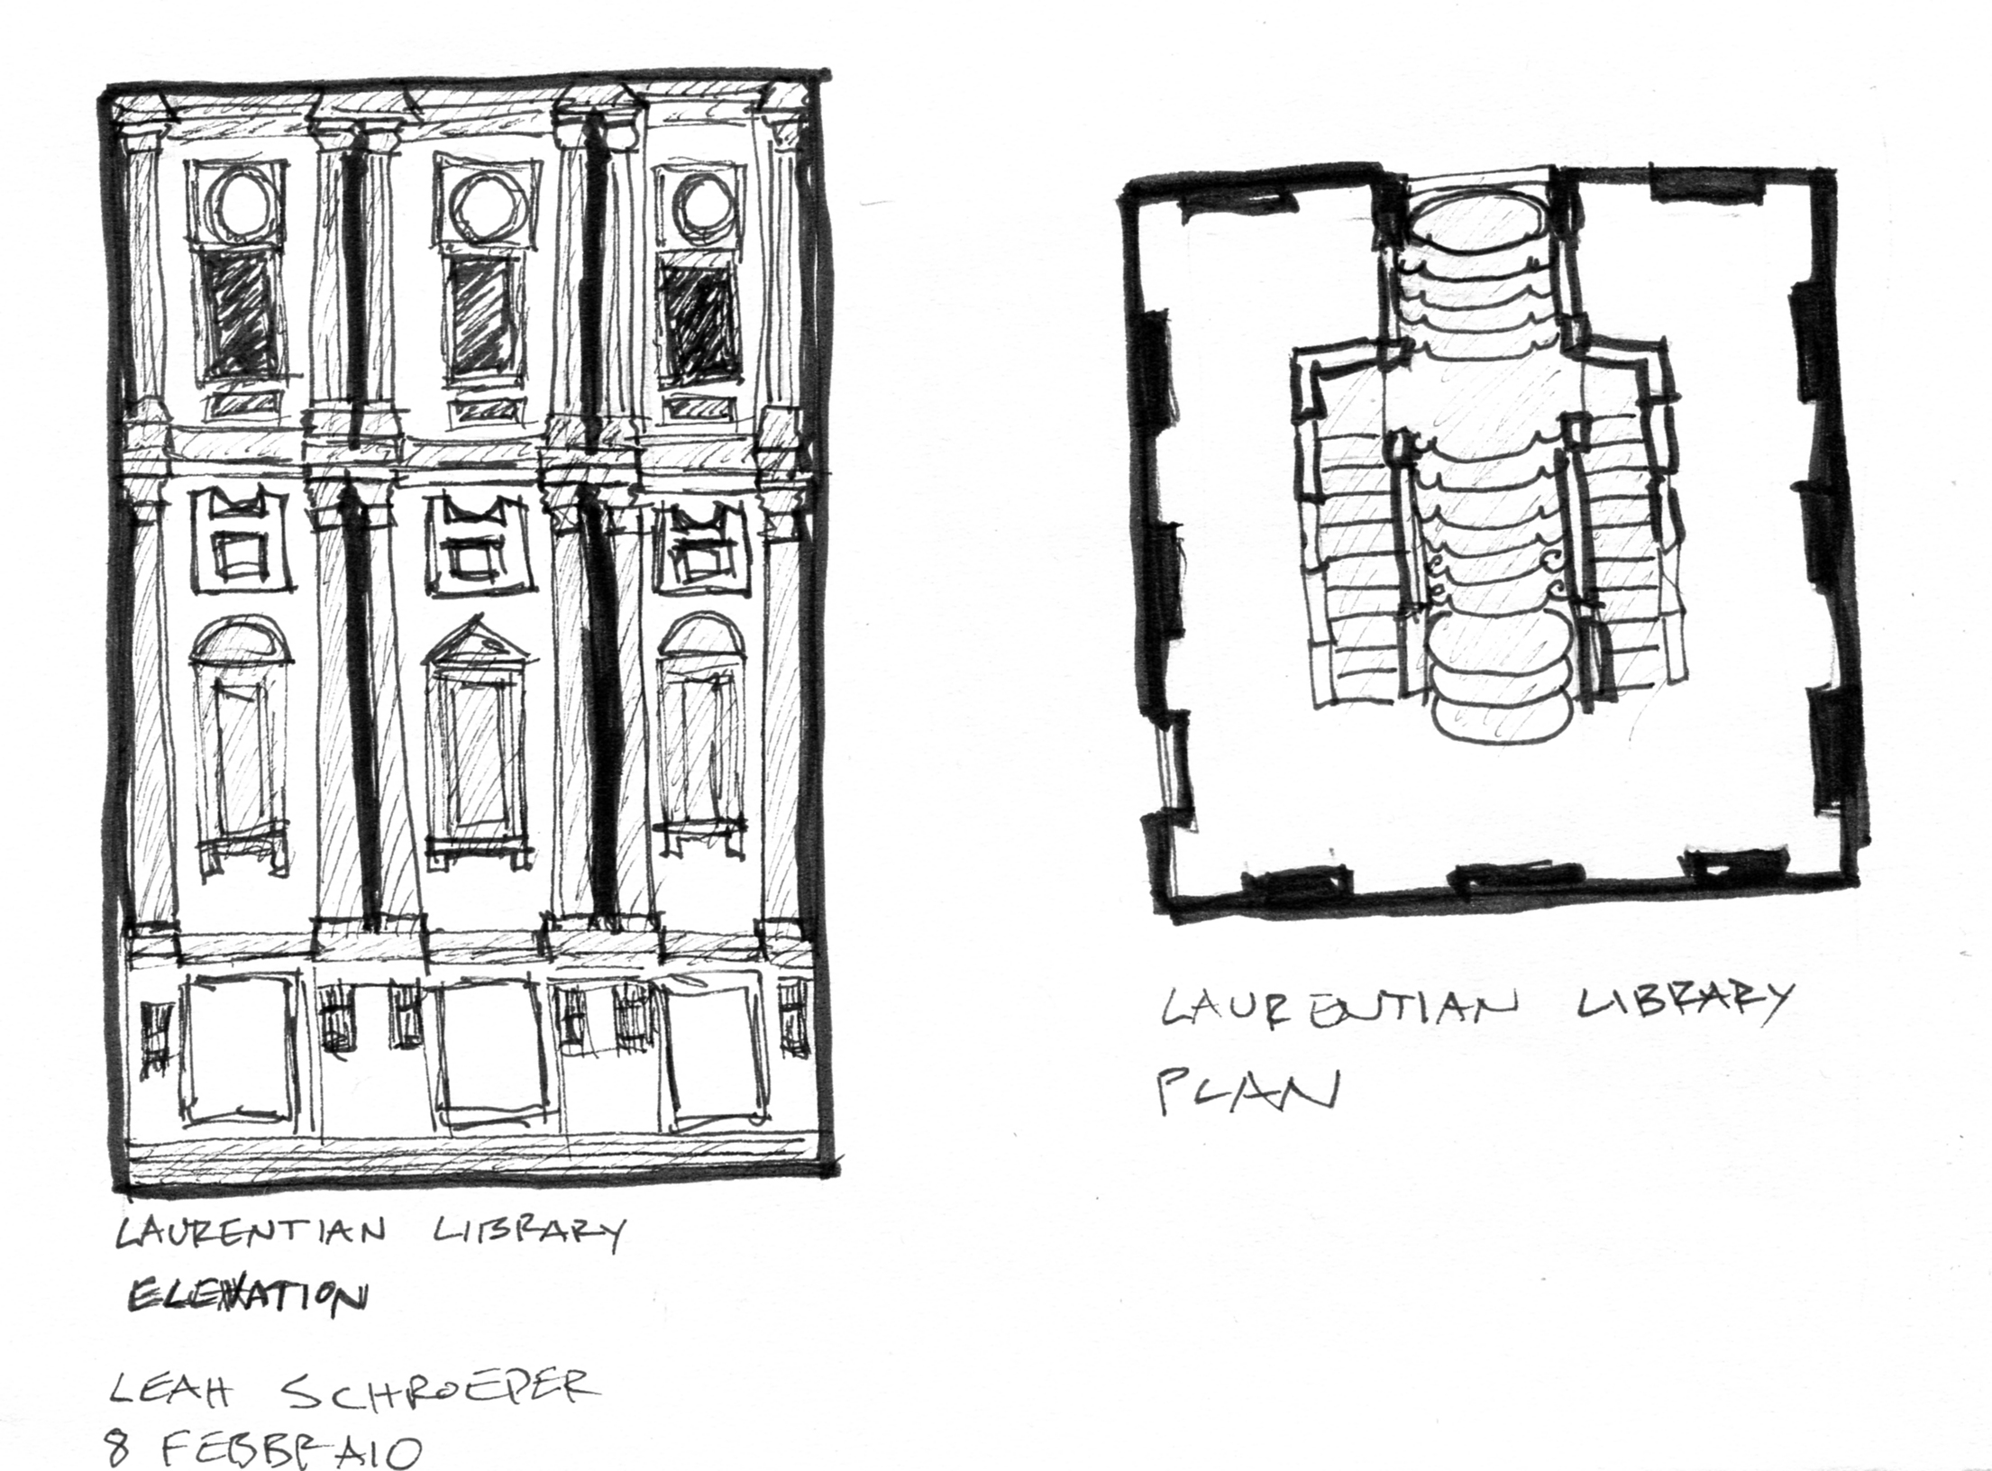
Laurentian Library Entry by Leah Schroeder

Slide 21
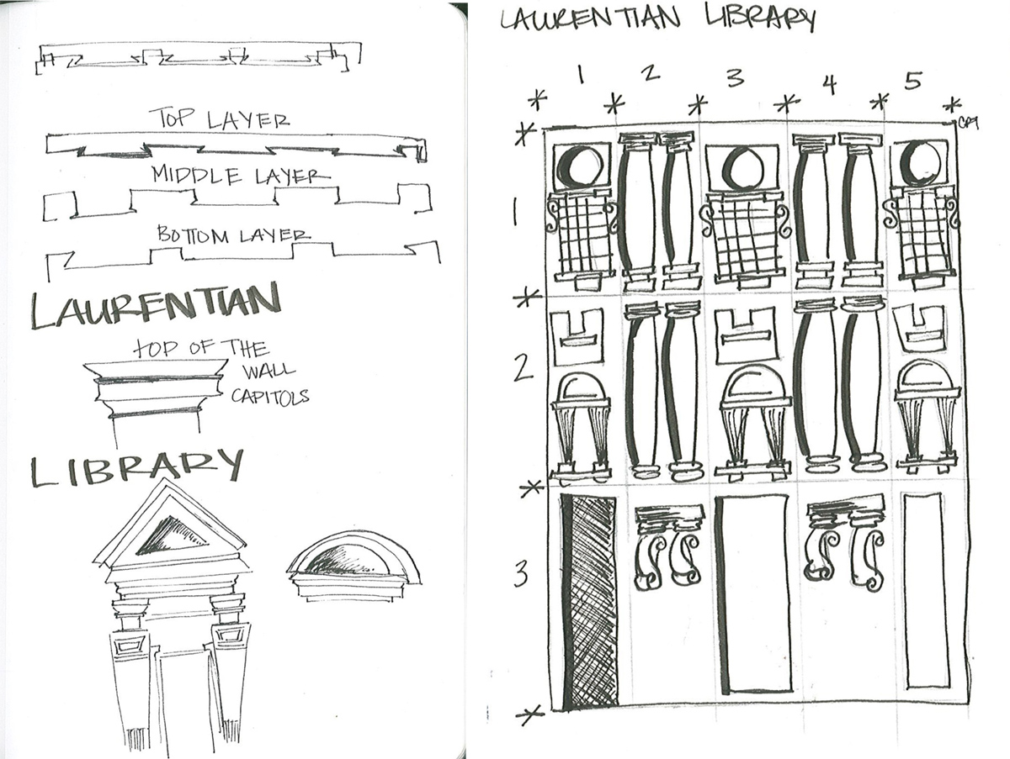
Laurentian Library by Caty Townsend

Slide 22
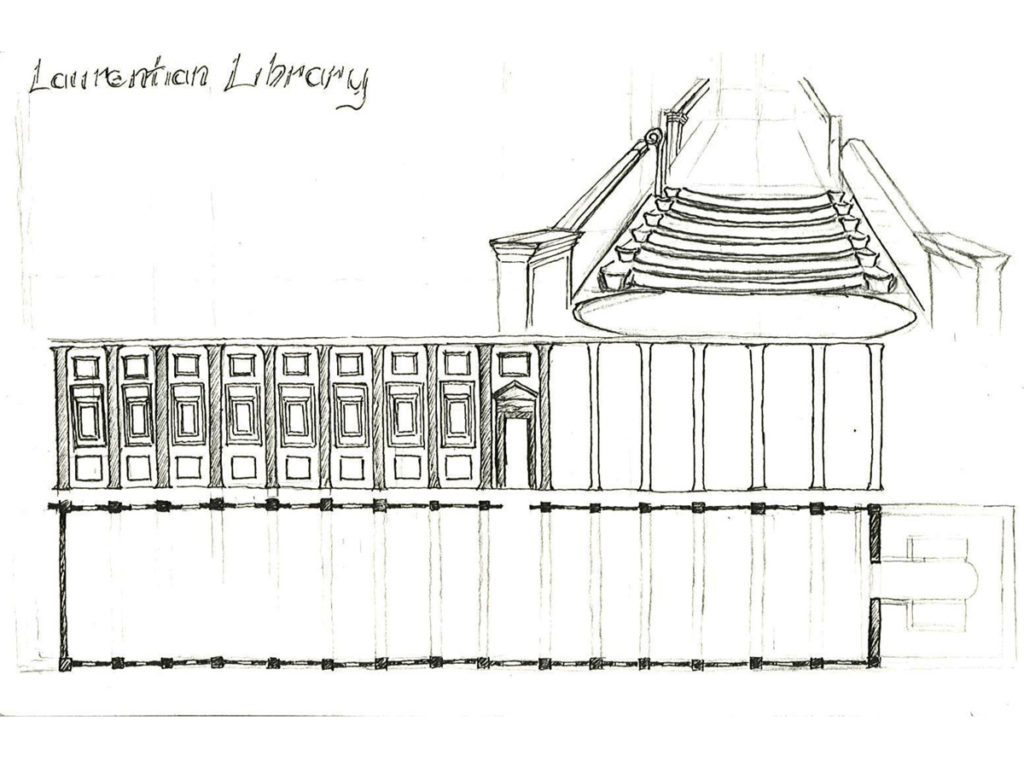
Laurentian Library Entry Stair and Reading Room by Minh Tran

Slide 23
Laurentian Library Entry by Ryan Williams

Slide 24
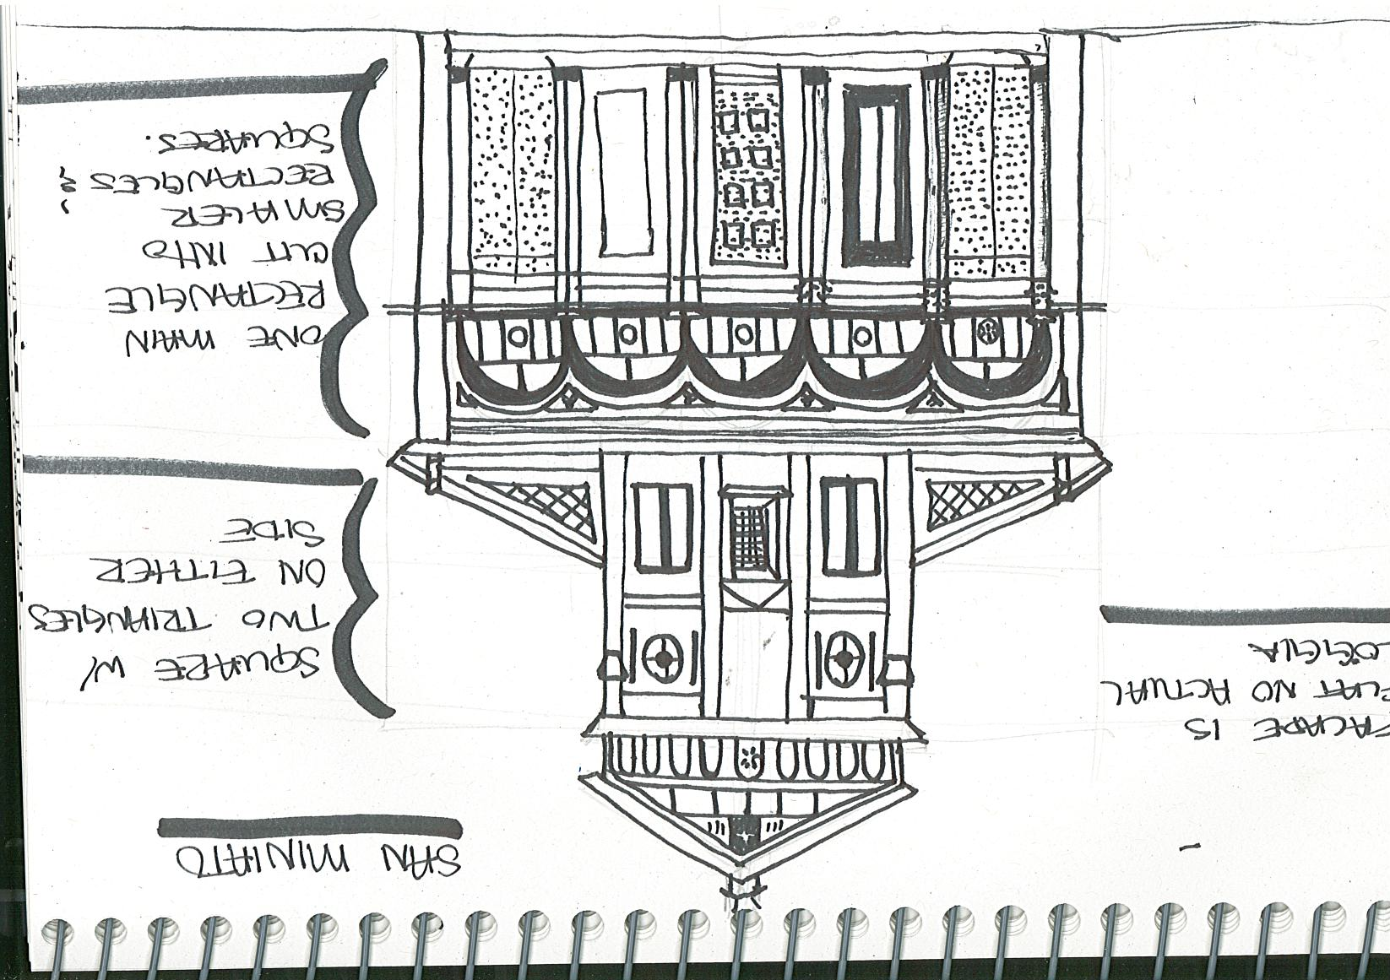
San Miniato by Ana Hernandez

Slide 25
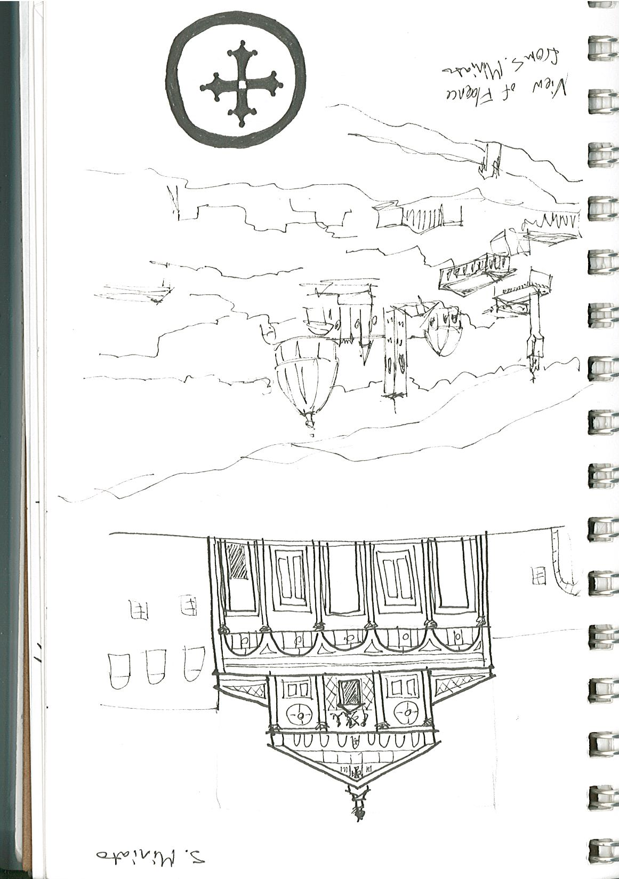
San Miniato and view of Florence by Annie Kientz

Slide 26
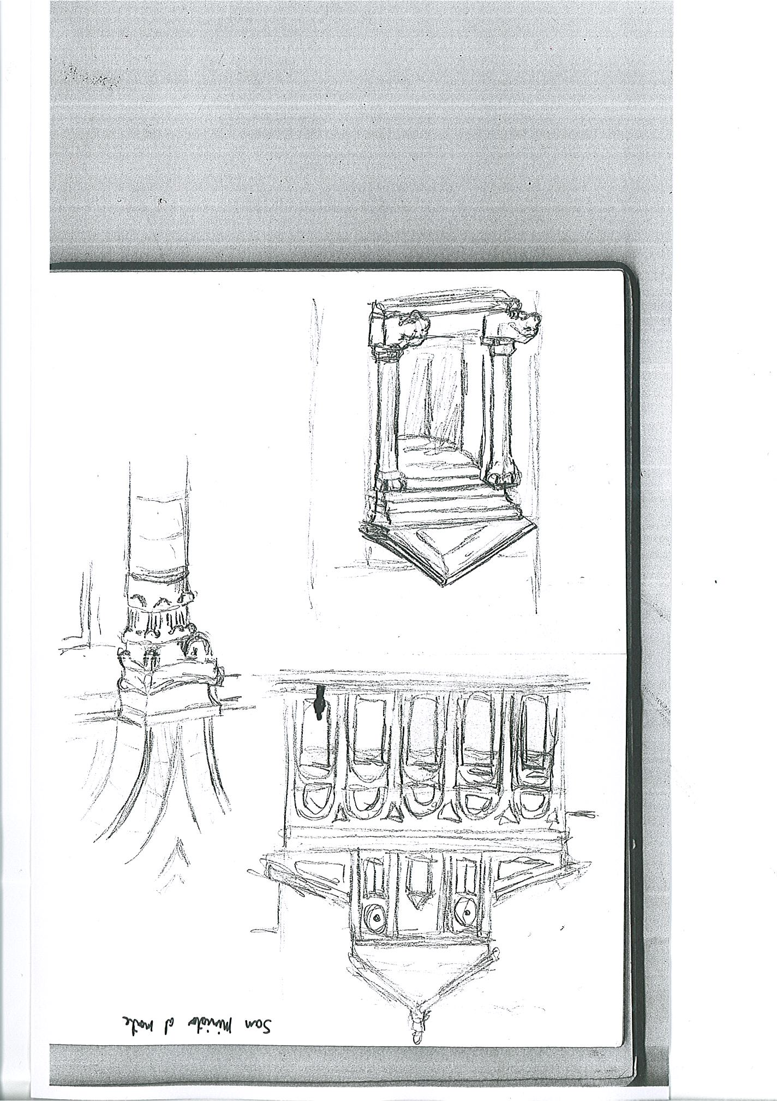
San Miniato by Erik Medina

Slide 27
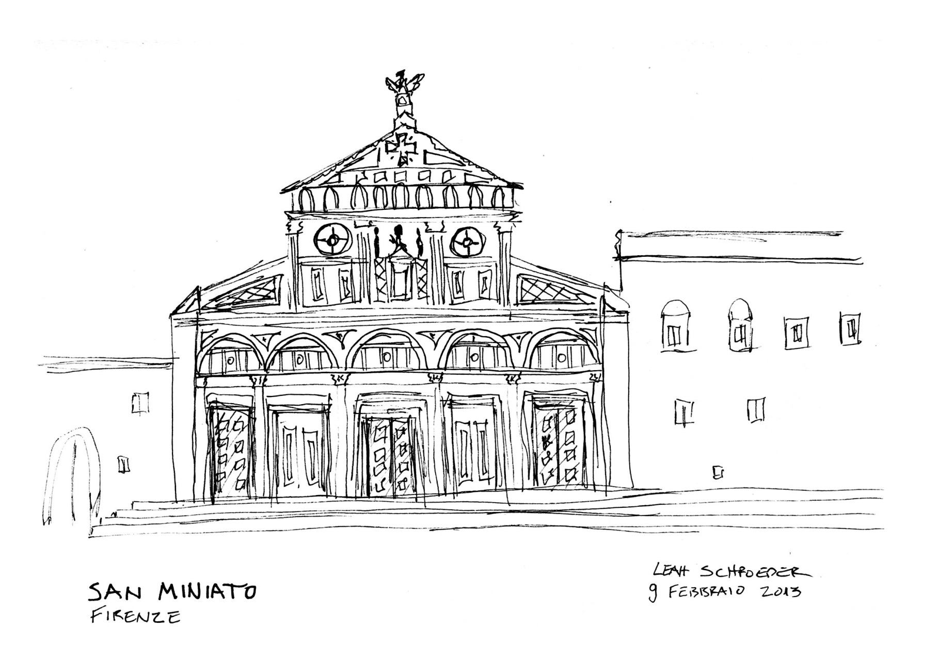
San Miniato by Leah Schroeder

Slide 28
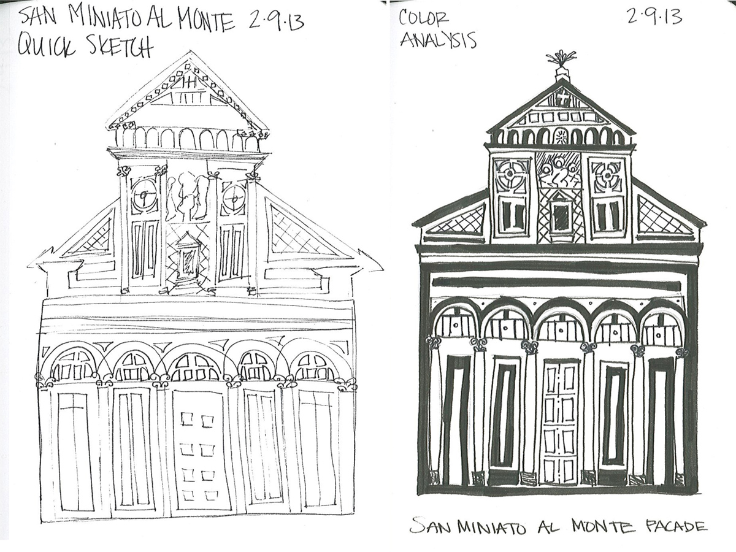
San Miniato by Caty Townsend

